Slide 1
Unit-II
Introduction
Object-oriented analysis and design (OOAD) is a popular technical approach to analyzing, designing an application, system, by applying the object-oriented paradigm and visual modeling throughout the development life cycles to foster better stakeholder communication and product quality.

Slide 2
What Is the UML?
The UML is a graphical language for
Visualizing
Specifying
Constructing
Documenting
the work products of software systems.
The Unified Modelling Language (UML) is an industry standard language.
UML is a process-independent language.
Notes:
The software systems that you develop today are more complex than the human mind can comprehend. This is why you model systems. Your model selection profoundly influences how you attack the problem and shape the solution.
No single model is sufficient. Every complex system is best approached through a small set of nearly independent models.
Therefore, to increase comprehension, a common language like the Unified Modeling Language (UML) is used to express models.
A modeling language is a language whose vocabulary and rules focus on the conceptual and physical representation of a system. A modeling language like the UML is a standard language for software blueprints.
Introduce the UML. Remember many of your students have no idea what the UML really is.
The next four slides explain how the UML is a language for visualizing, specifying, constructing and documenting.

Slide 3
Why We Model ?
We build models so that we can better understand the system we are developing
Analyse the problem-domain
simplify reality
capture requirements
visualize the system in its entirety
specify the structure and/or behaviour of the system
Design the solution
document the solution - in terms of its structure, behaviour, etc.

Slide 4
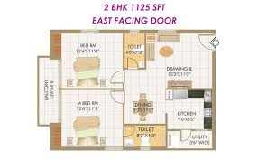
The Importance of Modeling
A model is “a complete description of a system”
Notes:
According to Grady Booch, IBM Fellow, a model provides the blueprints of a system. Models may encompass detailed plans, as well as more general plans that give a 30,000-foot view of the system under construction. A good model includes those elements that are not relevant to the given level of abstraction. Every system may be described from different aspects using different models, and each model is therefore a semantically closed abstraction of the system. A model may be structural, emphasizing the organization of the system, or it may be behavioral, emphasizing the dynamics of the system.
Define what is meant by the term “model.”

Slide 5
Model
A model is a simplification of reality.
A model provides the blueprints of a system.
A model may be structural(emphasizing the organization of the system), or it may be behavioural, (emphasizing the dynamics of the system).

Slide 6
Why Model?
Modeling achieves four aims:
Helps you to visualize a system.
Permits you to specify the structure or behavior of a system.
Gives you a template that guides you in constructing a system.
Documents the decisions you have made.
You build models of complex systems because you cannot comprehend such a system in its entirety.
Notes:
According to Booch in The Unified Modeling Language User Guide, modeling achieves four aims:
1. Models help you to visualize a system, as you want it to be. A model helps the software team communicate the vision for the system being developed. It is difficult for a software team to have a unified vision of a system that is described only in specification and requirement documents. Models bring about understanding of the system.
2. Models permit you to specify the structure of behavior of a system. A model allows how to document system behavior and structure before coding the system.
3. Models give a template that guide you in constructing a system. A model is an invaluable tool during construction. It serves as a road map for a developer. Have you experienced a situation where a developer coded incorrect behavior because he or she was confused over the wording in a requirements document? Modeling helps alleviate that situation.
4. Models document the decisions you’ve made. Models are valuable tools in the long term because they give “hard” information on design decisions. You don’t need to rely on someone’s memory.
Sell the students on the value of visual modeling.
Clarify that you are discussing formal modeling, not modeling written on a white board or on the back of a napkin at lunch.

Slide 7
The UML Is a Language for Visualizing
Communicating conceptual models to others is prone to error unless everyone involved speaks the same language.
There are things about a software system you can’t understand unless you build models.
An explicit model facilitates communication.
Notes:
Typically, projects and organizations develop their own language for modeling systems, making it difficult for outsiders and new team members to understand what is going on.
Communicating these conceptual models to others is prone to error unless everyone involved speaks the same language. The UML offers a set of symbols that represents well-defined semantics. One developer can write a model in the UML, and another developer can interpret that model unambiguously.
There are things about a software system you can’t understand unless you build models that transcend the textual programming language. For example, the meaning of a class hierarchy can be inferred, but not directly grasped, by staring at the code for all the classes in the hierarchy. The UML is a graphical language that addresses this problem.
If the developer who cut the code never wrote down the models, the information would be lost forever. At best, the information would only be partially recoverable from the implementation after the developer has moved on. Writing models in the UML addresses this issue. An explicit model facilitates communication. (The Unified Modeling Language User Guide, Booch, 1999.)
Stress how the UML is designed to promote communication using pictures rather than text.
Using the UML allows the “light bulb” to go on in the minds of many people. Rather than trying to interpret a textual description of a system design, the UML offers a graphical representation of that same description.
In this case, a picture is truly worth a thousand words.

Slide 8
The UML Is a Language for Specifying
The UML builds models that are precise, unambiguous, and complete.

Slide 9
The UML Is a Language for Constructing
UML models can be directly connected to a variety of programming languages.
Maps to Java, C++, Visual Basic, and so on
Permits forward engineering: Generation of Source Code from UML Model.
Permits reverse engineering: Generation of UML Model from Source Code
Notes:
The UML is not a visual programming language. However, models using the UML can be directly connected to a variety of programming languages, making it possible to map from a model in the UML to a programming language or even to a database.
If it is best expressed graphically, it is done graphically in the UML. If it is best expressed textually, it is done in the programming language.
This mapping permits forward engineering: the generation of code from a UML model to a programming language. Reverse engineering is also possible: the reconstruction of a model from implementation back into the UML.
The UML was designed with forward and reverse engineering in mind.
Rational has partners who provide round-trip engineering for other languages.

Slide 10
The UML Is a Language for Documenting
The UML addresses documentation of system architecture, requirements, tests, project planning, and release management.

Slide 11
UML Application Areas
The UML is intended primarily for Software intensive systems. It has been used effectively for such domains as follows:
Enterprise information systems
Banking and financial services
Telecommunications
Transportation
Defense
Medical , Electronics, scientific and Distributed web-based services.

Slide 12
Principles of Modeling
The choice of what models to create has a profound influence on how a problem is attacked and how a solution is shaped.
Every model may be expressed at different levels of precision.
The best models are connected to reality.
No single model is sufficient. Every nontrivial system is best approached through a small set of nearly independent models.

Slide 13
Conceptual Model of UML

Slide 14
A Conceptual Model of the UML
To understand the UML, a conceptual model of the language is need to form and it requires the three major elements:
Building blocks of the UML.
Rules that dictate how these building blocks may be put together.
Common mechanisms that apply throughout the UML.

Slide 15
1. Building blocks of the UML
The UML consists of three kinds of building blocks:
Things- These are the abstractions that are first-class citizens in a model.
Relationships-Tie the above things together.
Diagrams-Group interesting collections of things,

Slide 16
Building Blocks of UML
Things
Relationships
Diagrams
Class, Interface,
Active class, Use case,
Component,
Collaboration, Node
Structural
Dependency,
Generalization,
Associations,
Realization
Use case,
Class,
Object,
Sequence,
Collaboration,
State chart,
Activity,
Component,
Deployment.
Behavioral
Interaction,
State Machine
Grouping
Package
Annotational
Note

Slide 17
Things in the UML
There are 4 kinds of things in the UML
Structural Things
Behavioral Things
Grouping Things
Annotational Things

Slide 18
1. Structural Things
Structural things are the nouns of UML models. These are mostly static parts of a model, representing elements that are either conceptual or physical.
There are 7 kinds of Structural things:
Class
Interface
Collaboration
Use case
Active class
Component
Node

Slide 19
Class:-
A class is a description of a set of objects that share the same attributes, operations, relationships and semantics.
A class implements one or more interfaces.
Window
Origin Size
Open( ) Close( ) Move( ) Display( )
Name
Attributes
class
Operation

Slide 20
(2) Interface:-
Interface is a collection of operations that specify a service of a class or component.
An interface defines a set of operation specifications but never a set of operation implementations.
Graphically, an interface is represented as a circle with its name.

Slide 21
Interface Notation
ISpelling

Slide 22
(3) Collaboration:-
A collaboration defines an interaction and is a society of roles and other elements that work together to provide some cooperative behavior.
Graphically a collaboration is represented as an ellipse with dashed lines, usually including only its name.

Slide 23
(4) Use case:-
A Use case is a description of set of sequence of actions that a system performs, which results a value to a particular actor.

Slide 24
A use case is realized by a collaboration.
Withdraw money
Use case

Slide 25
The remaining three things- Active classes, components and nodes- all are class like, ie., they also describe a set of objects that share the same attributes, operations, relationships and semantics.

Slide 26
(5) Active class:-
An active class is a class whose objects own one or more processes or threads and therefore can initiate control activity.
Active Class initiate and control the flow of activity, while passive classes store data and serve other classes.
We illustrate active classes with a thicker border.

Slide 27
Graphically, an active class is represented like a class, but with heavy lines, usually including its name, attributes and operations.
Event manager
Suspend() Flush()
Active class

Slide 28
The remaining two elements –component and nodes- they represent physical things, where as previous five things ( class, interface, collaboration, usecase, active class) represent conceptual or logical things.

Slide 29
(6) Component:-
A component is a physical and replaceable part of a system that conforms to and provides the realization of a set of interfaces.
A component represents the physical packaging of logical elements such as classes, interfaces and collaborations.

Slide 30
orderform.java
Component

Slide 31
(7) Node:-
A node is physical element that exists at run-time and represents a computational resource, generally having some memory and processing capability.
A set of components may reside on a node and may also migrate from node to node.

Slide 32
Database server
Node

Slide 33
2. Behavioral Things
These are the dynamic parts of UML models.
These are the verbs of a model representing the behavior over time and space.
There are two types of behavioral things
1. Interaction
2. State machine.

Slide 34
Interaction:-
An Interaction is a behavior that comprises a set of messages exchanged among a set of objects within a particular context to perform a specific purpose.
display
Message

Slide 35
An interaction involves a number of other elements, including messages, action sequences and links. (connection between objects.)

Slide 36
2. State machine:-
A State machine is a behavior that specifies the sequences of states an object or an interaction goes through during its lifetime in response to events, together with its responses to those events.
waiting
State

Slide 37
A State machine involves a number of other elements, including states, transitions( the flow from state to state), events (things that trigger a transition), and activities ( the response to a transition).

Slide 38
3. Grouping Things
Grouping things are the organizational parts of UML models.
In all, there is one primary kind of grouping thing, namely, Package.

Slide 39
Package:- A Package is a general-purpose mechanism for organizing elements into groups.
Structural things, behavioral things and even other grouping things that may be placed in a package.

Slide 40
Ex.1
Ex. 2
io
Software
InputStreamReader
OutputStreamWriter
MS-Office
VLC media Player
JDK
Rational Software Architect
Package

Slide 41
4. Annotational Things
Annotational Things are the explanatory parts of the UML models.
These are the comments you may apply to describe and remark about any element in a model.
There is one primary kind of annotational thing, called a Note.

Slide 42
Note:- A Note is simply a symbol for representing constraints and comments attached to an element.
A note is rendered as a rectangle with a
dog-eared corner.
Return copy of self
Note

Slide 43
Relationships
A relationship is a connection among UML things.
In object-oriented modeling, the three most important relationships are dependencies, generalization and association.
Realization relation is used to specify the relationship between interface and class.

Slide 44
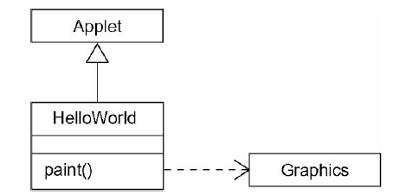
Relationships in models and Java Code
In Java, the applet for printing "Hello, World!" in a Web browser is quite simple:
import java.awt.Graphics;
class HelloWorld extends java.applet.Applet
{
public void paint (Graphics g)
{
g.drawString("Hello, World!", 10, 10);
}
}

Slide 45
(1) DEPENDENCY
A dependency is a using relationship that states that a change in specification of one thing may affect another thing that uses it.
Graphically, a dependency is rendered as a dashed directed line, directed to the thing being depended on.

Slide 46
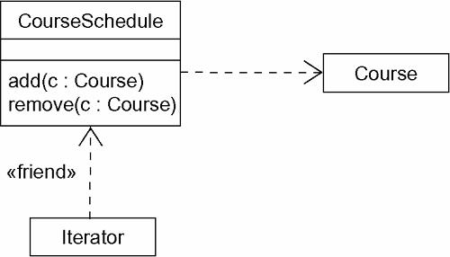

Slide 47
(2) GENERALIZTION
A Generalization is relationship between a general thing( called the Super class or parent) and a more specific kind of that thing( called the Subclass or child).
Generalization is sometimes called “is-a-kind of” relationship.
The method of a child has the same signature as method in a parent, then the child method overrides the method in a parent; this is known as Method Overriding.
Use generalizations when you want to show parent/child relationship.

Slide 48
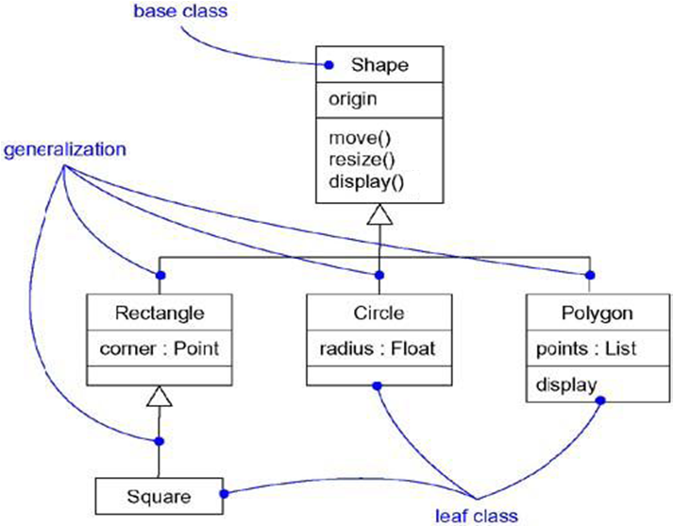

Slide 49
(3) ASSOCIATION
An Association is a structural relationship that specifies that objects of one thing are connected to objects of another.
Given an association connecting two classes, you can navigate from an object of one class to an object of the other class and vice versa.

Slide 50
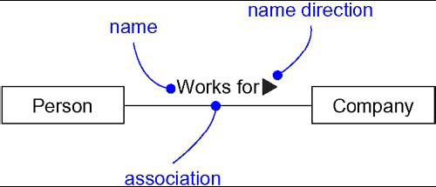
NAME

Slide 51
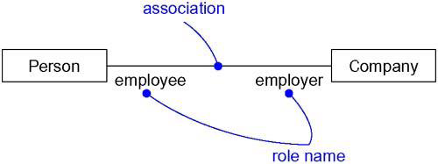
ROLE

Slide 52
MULTIPLICITY:-
An association represents a structural relationship among objects.
To state how many objects may be connected across an instance of an association.
This “how many” is called the multiplicity of an association’s role.

Slide 53
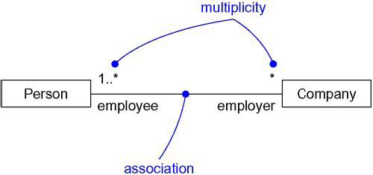
MULTIPLICITY

Slide 54
Association - Multiplicity
A cricket team has 11 players. One of them is the captain.
A player can play only for one Team.
The captain leads the team members.
Captain
Team
Team
Member
Player
1
0..1
10
11
member of
1
1
Captain
Leads
Notes:
1.

Slide 55
AGGREGATION:-
A plain association between two classes represents a structural relationship between peers.
To model a “ Whole/part” relationship, in which one class represents a large thing( the “whole”), which consists of smaller things ( the “Parts”). This kind of relationship is called AGGREGATION, which represents a “has-a” relationship, meaning that an object of the whole has objects of the part.

Slide 56
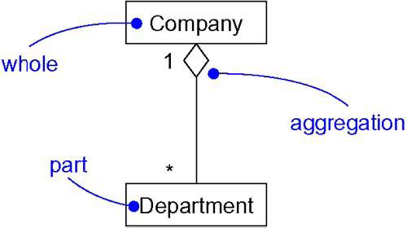
College
Aggregation

Slide 57
More Examples
For instance, we can model an aggregation between classes DegreeProgram and Course, since a course is part of a degree program and a course can be shared among two or more degree programs
(e.g. an engineering degree could share a C programming course with a computer science degree).
Use This Relationship Between
Body……Blood
Pen………tip, barrier, ink reservoir etc.

Slide 58
Aggregation is really just a special kind of association and is specified by adorning a plain association with an open diamond at the whole end.
Composition:-
Composition is a special form of aggregation within which the parts are inseparable from the whole.
Hand
Finger

Slide 59
Ex:
Blood….BloodCells.
Body….Heart
Body….Brain

Slide 60
Realization
A realization is a semantic relationship between classifiers in which one classifier specifies a contract that another classifier guarantees to carry out.
Graphically, a realization is rendered as a dashed directed line with a large open arrowhead pointing to the classifier that specifies the contract.

Slide 61
Realization is sufficiently different from dependency, generalization, and association relationships that it is treated as a separate kind of relationship.
You'll use realization in the context of interfaces

Slide 62
Realization is used to specify the relationship between an interface and the class or component that provides an operation or service.
An interface is a collection of operations that are used to specify a service of a class or a component.
Therefore, an interface specifies a contract that a class or component must carry out.
An interface may be realized by many such classes or components, and a class or component may realize many interfaces.

Slide 63
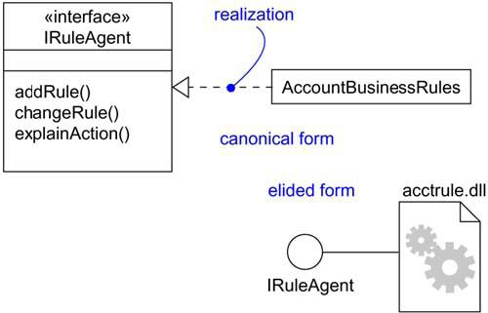
Note that you can represent realization in two ways: in the canonical form (using the interface stereotype and the dashed directed line with a large open arrowhead) and in an elided form (using the interface lollipop notation).
Realization of an Interface

Slide 64
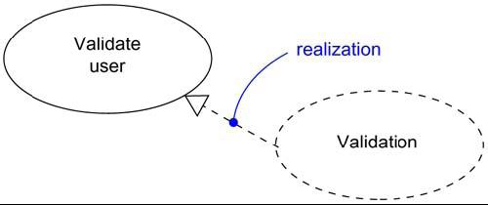
You'll also use realization to specify the relationship between a use case and the collaboration that realizes that use case,
In this circumstance, you'll almost always use the canonical form of realization.
Realization of a Use Case

Slide 65
COMMON MODELING TECHNIQUES
Modeling Simple Dependencies:-
Create a Dependency pointing from the class with the operation
to the class used as a parameter in the operation.

Slide 66
Modeling Single Inheritance:-
Given a set of classes, look for responsibilities, attributes and operations which are common to two or more classes.
Elevate these common responsibilities, attributes and operations to a more general class. If necessary create a new class to which we can assign these elements.
Specify that the more-specific classes inherit from more-general class by placing a generalization relationship that is drawn from each specialized class to its more-general parent.

Slide 67
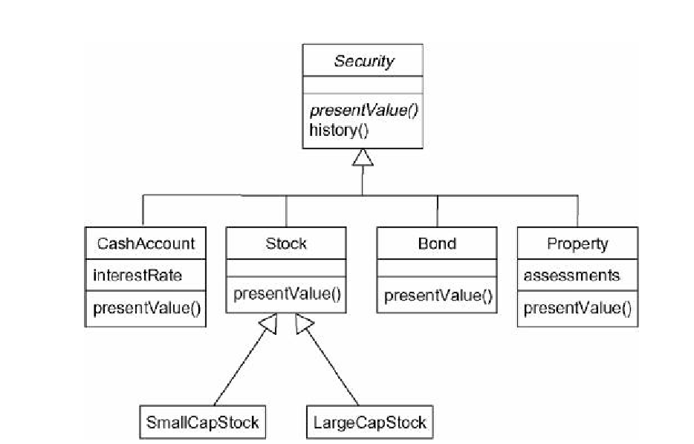
Inheritance Relationships

Slide 68
Modeling Structural Relationships:-
For each pair of classes, if we need to navigate from objects of one class to objects of another class, specify an association between the two.
For each of these associations, specify a multiplicity as well as role names.
If one of the classes in an association is structurally or organizationally a whole compared with the classes at the other end look like parts, mark this as an aggregation by adorning the association at the end near the whole.

Slide 69
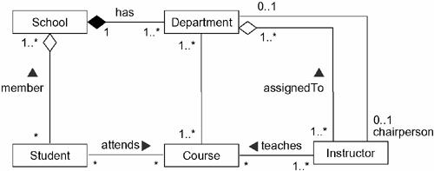
Structural Relationships

Slide 70
Diagrams in the UML
A diagram is the graphical presentation of a set of things and relationships.
We draw diagrams to visualize a system from different perspectives.
Diagrams in the UML are broadly, classified into 2 types, namely
1.Structural Diagrams and
2. Behavioral Diagrams
Structural Diagrams (4) Behavioral Diagrams(5)
1.Class Diagram 1.Usecase Diagram
2.Object Diagram 2.Sequence Diagram
3. Component Diagram 3. Collaboration Diagram
4. Deployment Diagram 4.Activity Diagram
5. Statechart Diagram

Slide 71
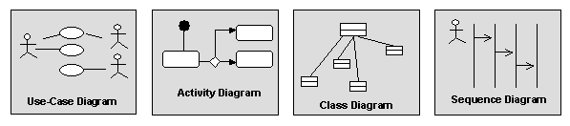
Diagrams
Diagrams graphically depict a view of a part of your model.
Different diagrams represent different views of the system that you are developing.
A model element will appear on one or more diagrams.
Notes:
Diagrams provide a means of visualizing and manipulating the model elements.

Slide 72
UML Diagrams in Software Architecture
Structural Diagrams
Use-Case
Diagrams
Class
Diagrams
Composite
Structure
Diagrams
Sequence
Diagrams
Communication
Diagrams
Component
Diagrams
Model
State Machine
Diagrams
Deployment
Diagrams
Activity
Diagrams
Behavioral Diagrams
Notes:
Visual models of a system require many different diagrams to represent different views of the system for different project stakeholders. The UML provides a rich notation for visualizing models, including the following key diagrams:
Use-Case diagrams to illustrate user interactions with the system
Class diagrams to illustrate logical structure
Composite Structure diagrams to show the internal structure of a class or component at runtime
Component diagrams to illustrate the organization and dependencies among modular parts of the system
Deployment diagrams to show the mapping of software to hardware configurations
Activity diagrams to illustrate flows of events
State Machine diagrams to illustrate the series of states an object can have
Communication diagrams to illustrate behavior in terms of how objects interact
Sequence diagrams to illustrate behavior in terms of the sequence of interactions between objects

Slide 73
Structural Diagrams
The UML's four structural diagrams represent the static aspects of a system.
The static aspects of a system means the existence and placement of things.

Slide 74
The UML's structural diagrams are roughly organized around the major groups of things like
1.Class diagram---Classes, interfaces, and collaborations
2. Object diagram--- Objects
3. Component diagram---Components
4. Deployment diagram---Nodes

Slide 75
Behavioral Diagrams
The UML's five behavioral diagrams represent the dynamic aspects of a system.
Dynamic aspects of a system means changing parts of the system.
The dynamic aspects of a software system include the flow of messages between the objects over time and space.

Slide 76
1. Use case diagram--- Organizes the behaviors of the system.
2. Sequence diagram ---Focused on the time ordering of messages.
3. Collaboration diagram---Focused on the structural organization of objects that send and receive messages.
4. Statechart diagram---Focused on the changing state of a system driven by events.
5. Activity diagram---Focused on the flow of control from activity to activity.

Slide 77
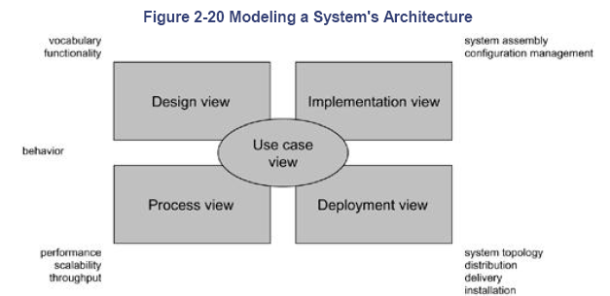

Slide 78
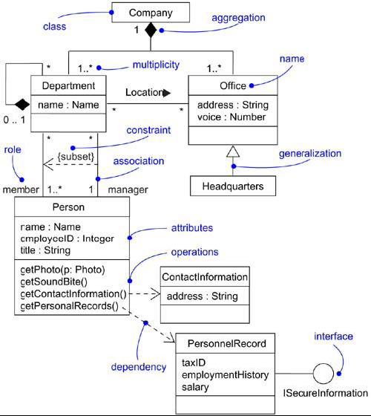
1.Class Diagram
A class diagram shows a set of classes, interfaces, and collaborations and their relationships.
Class diagrams are used to illustrate the static design view of a system.

Slide 79
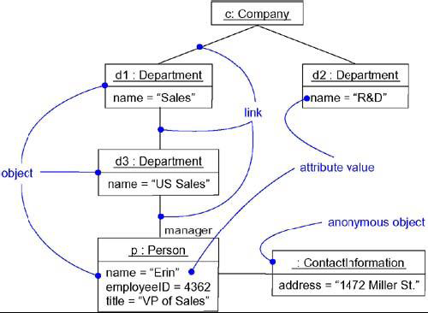
2. Object Diagram
An object diagram
shows a set of objects and their relationships.
Object diagrams address the static design view or static process view of a system just as do class diagrams.

Slide 80
3. Component Diagram
A component diagram shows a set of components and their relationships.
Component diagrams are used to illustrate the static implementation view of a system.
Component diagrams are related to class diagrams in that a component typically maps to one or more classes, interfaces, or collaborations.

Slide 81
4. Deployment Diagram
A deployment diagram shows a set of nodes and their relationships.
Deployment diagrams are used to illustrate the static deployment view of an architecture.
Deployment diagrams are related to component diagrams in that a node typically encloses one or more components.

Slide 82
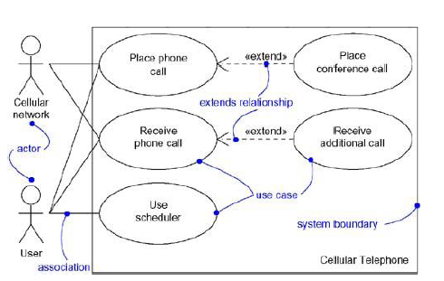
Use Case Diagram
A use case diagram shows a set of use cases and actors (a special kind of class) and their relationships.
Apply use case diagrams to illustrate the static use case view of a system.
Use case diagrams are especially important in organizing and modeling the behaviors of a system.

Slide 83
Interaction diagram
Interaction diagram is the collective name given to sequence diagrams and collaboration diagrams.
Both sequence diagrams and collaboration diagrams are kinds of interaction diagrams.
An interaction diagrams shows an interaction, consisting of a set of objects and their relationships, including the messages that may be dispatched among them.
Interaction diagrams address the dynamic view of a system.

Slide 84
Interaction Diagrams
A sequence diagram is an interaction diagram that emphasizes the time ordering of messages.
A collaboration diagram is an interaction diagram that emphasizes the structural organization of the objects that send and receive messages.
Sequence diagrams and collaboration diagrams are isomorphic, meaning that you take one and transform it into the other.

Slide 85
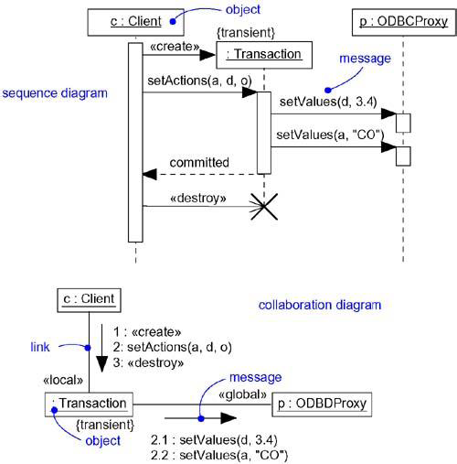
1.Sequence Diagram 2. Collaboration Diagram

Slide 86
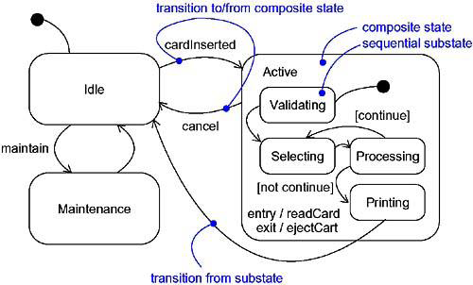
Statechart Diagram
A statechart diagram shows a state machine, consisting of states, transitions, events, and activities.
Use statechart diagrams to illustrate the dynamic view of a system.
Statechart diagrams emphasize the event-ordered behavior of an object, which is especially useful in modeling reactive systems.

Slide 87
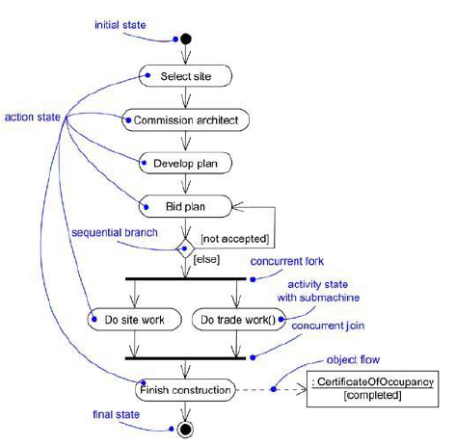
Activity Diagram
An activity diagram shows the flow from activity to activity within a system.
An activity shows a set of activities, the sequential or branching flow from activity to activity.
Use activity diagrams to illustrate the dynamic view of a system.
Activity diagrams emphasize the flow of control among objects.

Slide 88
Rules of the UML
The UML's building blocks can't simply be thrown together in a random fashion.
Like any language, the UML has a number of rules that specify what a well-formed model should look like.
A well-formed model is one that is semantically self-consistent and in harmony (accordingly) with all its related models.

Slide 89
The UML has semantic rules for:-
Names- What you can call things, relationships and diagrams.
Scope- The context that gives specific meaning to a name.
Visibility- How those names can be seen and used by others.
Integrity- How things properly and consistently relate to one another.
Execution- What it means to run or simulate a dynamic model.

Slide 90
Models built during the development of a software-intensive system tend to evolve and may be viewed by many stakeholders in different ways and at different times.
For this reason, it is common for the development team to not only build models that are well-formed, but also
to build models that are
Elided Certain elements are hidden to simplify the view
Incomplete Certain elements may be missing
Inconsistent The integrity of the model is not guaranteed

Slide 91
3.Common Mechanisms
The 4 common mechanisms that apply consistently throughout the language.
Specifications
Adornments
Common Divisions
Extensibility mechanisms

Slide 92
Specifications:-
The UML is more than just a graphical language. Rather, behind every part of graphical notation there is a specification that provides a textual statement of the syntax and semantics of that building block.
For example, behind a class icon is a specification that provides the full set of attributes, operations and behaviors.
You use the UML’s graphical notation to visualize a system; you use the UML’s specification to state the system details.

Slide 93
2. Adornments:-
Adornments Textual/graphical items added to the basic notation of an element.
Used for visualizing details from the element’s specification
Example: The basic notation of association is a line, but this could be adorned with additional details, such as the role and multiplicity of each end.
The most important kind of adornments are notes.
0..1
*
Employer
Employee

Slide 95
3.Common Divisions
Abstraction vs. manifestation
Class vs. object
Most UML building blocks have this kind of class/object distinction.
Interface vs. implementation
An interface declares a contract, and an implementation represents one concrete realization of that contract.

Slide 96
Customer
name address phone
Jan :Customer
:Customer
Elyse
Classes and Objects

Slide 97
SpellingWizard.dll
IUnknown
ISpelling
Interfaces and Implementations

Slide 98
4.Extensibility Mechanisms
Allows you to extend the language by adding new building blocks, creating new properties and specifying new semantics. Includes:
Stereotypes
Tagged values
Constraints

Slide 99
Stereotypes
Extend the vocabulary of the UML by creating new model elements derived from existing ones but that have specific properties suitable for your domain/problem.

Slide 100
Stereotype
EventQueue
{version =3.2
Author=egb }
Tagged value
<< Exception>>
Overflow
add( )
remove( )
flush( )
{ordered}
Constraints
Extensibility Mechanisms

Slide 101
Example: In Java, you sometimes have to model
classes such as exceptions.
Only want them to be thrown and caught
Can make them first class citizens in your model, ie treating them like basic building blocks, by marking them with a suitable stereotype.

Slide 102
Graphically, a stereotype is rendered as a name enclosed by guillemots and placed above the name of another element (eg, <<name>>)
Alternatively, you can render the stereotyped element by using a new icon associated with that stereotype

Slide 103
Named stereotype
Named stereotype with icon
Stereotyped element as icon
<<metaclass>>
Model Element
<<exceptions>>
Underflow !
HumiditySensor

Slide 104
2.Tagged values:-
Properties for specifying key-value pairs of model elements, where
keywords are attributes.
Extend the properties of a UML building block, allowing you to
create new information in that elements specification.
Can be defined for existing elements of the UML

Slide 105
Stereotype
EventQueue
{version =3.2
Author=egb }
Tagged value
<< Exception>>
Overflow
add( )
remove( )
flush( )
{ordered}
Constraints
Extensibility Mechanisms

Slide 106
3.Constraints:-
Properties for specifying semantics or conditions that must be maintained as true for model elements.
Extend the semantics of a UML building block, allowing you to add new rules, or modify existing ones.
Example:- you might want to constrain the EventQueue class so that all additions are done in order.

Slide 107
Stereotype
EventQueue
{version =3.2
Author=egb }
Tagged value
<< Exception>>
Overflow
add( )
remove( )
flush( )
{ordered}
Constraints
Extensibility Mechanisms

Slide 108
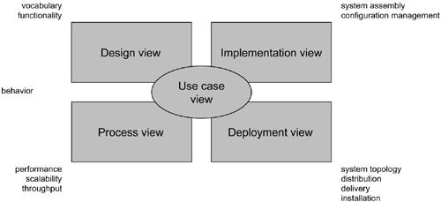
Architecture
Modeling a System's Architecture

Slide 109
Use case view
The use case view of a system includes the use cases that describe the behavior of the system as seen by its end users, analysts, and testers.
This view doesn’t specify the organization of a software system. Rather, it Specify the shape of the system's architecture.
The static aspects of this view are captured in use case diagrams; and the dynamic aspects of this view are captured in interaction diagrams, statechart diagrams, and activity diagrams.

Slide 110
Design view
The design view of a system includes the classes, interfaces, and collaborations that form the vocabulary of the problem and its solution.
This view primarily supports the functional requirements of the system, meaning the services that the system should provide to its end users.
The static aspects of this view are captured in class diagrams and object diagrams and the dynamic aspects of this view are captured in interaction diagrams, statechart diagrams, and activity diagrams.

Slide 111
Process view
The process view of a system includes the threads and processes that form the system's concurrency and synchronization mechanisms.
This view primarily addresses the performance, scalability, and throughput of the system.
The static and dynamic aspects of this view are captured in the same kinds of diagrams as for the design view, but with a focus on the active classes that represent these threads and processes.

Slide 112
Implementation view
The implementation view of a system includes the components and files that are used to assemble and release the physical system.
This view primarily addresses the configuration management of the system's releases, made up of somewhat independent components and files that can be assembled in various ways to produce a running system.
The static aspects of this view are captured in component diagrams; the dynamic aspects of this view are captured in interaction diagrams, statechart diagrams, and activity diagrams.

Slide 113
Deployment view
The deployment view of a system includes the nodes that form the system's hardware topology on which the system executes.
This view primarily addresses the distribution, delivery, and installation of the parts that make up the physical system.
The static aspects of this view are captured in deployment diagrams; the dynamic aspects of this view are captured in interaction diagrams, statechart diagrams, and activity diagrams.

Slide 114
Software Development Life cycle
The UML is largely process-independent, meaning that it is not tied to any particular software development life cycle.
However, to get the most benefit from the UML, you should consider a process that is
Use case driven
Architecture-centric
Iterative and incremental

Slide 115
Use case Driven
Use case driven means
use cases are used as a primary artifact for establishing the desired behavior of the system, for verifying and validating the system's architecture, testing, communicating among the stakeholders of the project.

Slide 116
Architecture-Centric
Architecture-centric means
System's architecture is used as a primary artifact for conceptualizing, constructing, managing, and evolving the system under development.

Slide 117
Iterative Process
An iterative process is one that involves managing a stream of executable releases.
It involves the continuous integration of the system's architecture to produce these releases, with each new release embodying incremental improvements over the other.

Slide 118
Together, an iterative and incremental process is risk-driven, meaning that each new release is focused on attacking and reducing the most significant risks to the success of the project.
This use case driven, architecture-centric, and iterative/incremental process can be broken into phases.
A phase is the span of time between two major milestones of the process, when a well defined set of objectives are met, artifacts are completed, and decisions are made whether to move into the next phase.

Slide 119
There are four phases in the software development life cycle: inception, elaboration, construction, and transition.

Slide 120
Inception is the first phase of the process, the basic idea for the development.
Elaboration is the second phase of the process, the product vision and its architecture are defined.
Construction is the third phase of the process, the software is brought from an executable architectural baseline to being ready to be transitioned to the user community.
Transition is the fourth phase of the process, when the software is turned into the hands of the user community.

Slide 121
END

